Slide 1

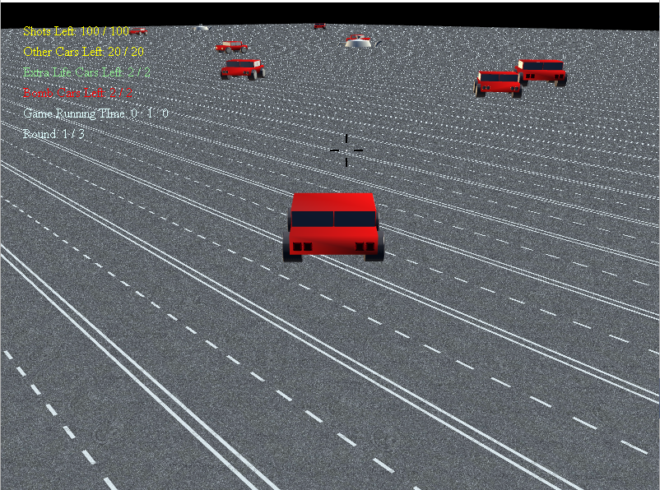
Car Shooter
By: Juan Estrella

Slide 2
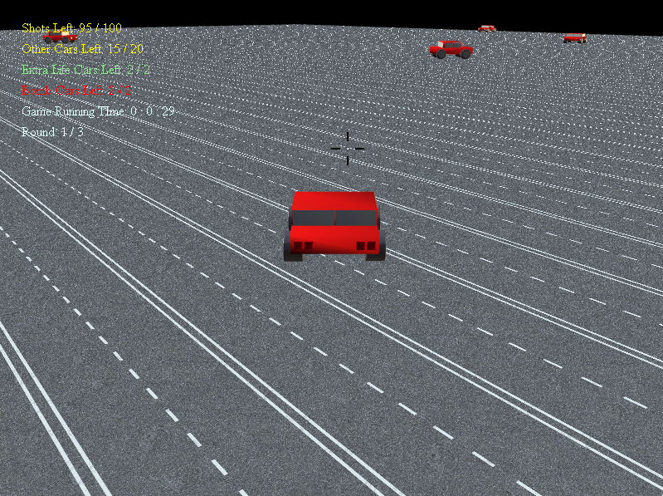
You can move around with WASD and point to shoot or arrow keys to move crosshair to shoot other cars!

Slide 3


There are indicators of Shots left, Cars left, Running Time, and Round.

Slide 4
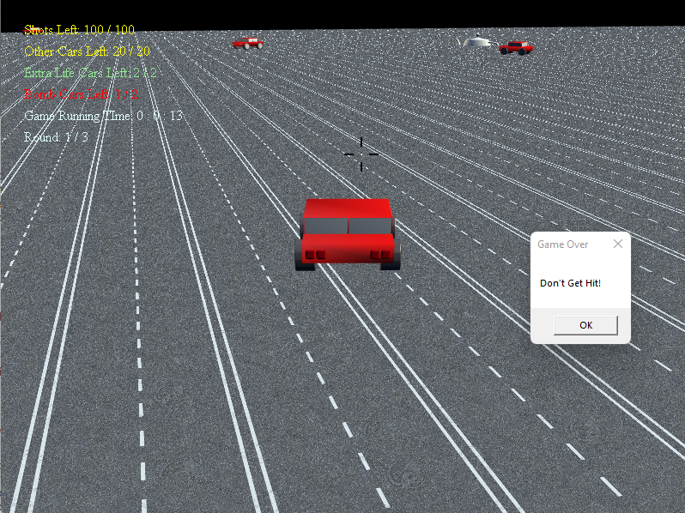





You need to watch out for the Bombs (look like teapots) and Cars to not hit or get hit (front or back) or you LOSE!

Slide 5
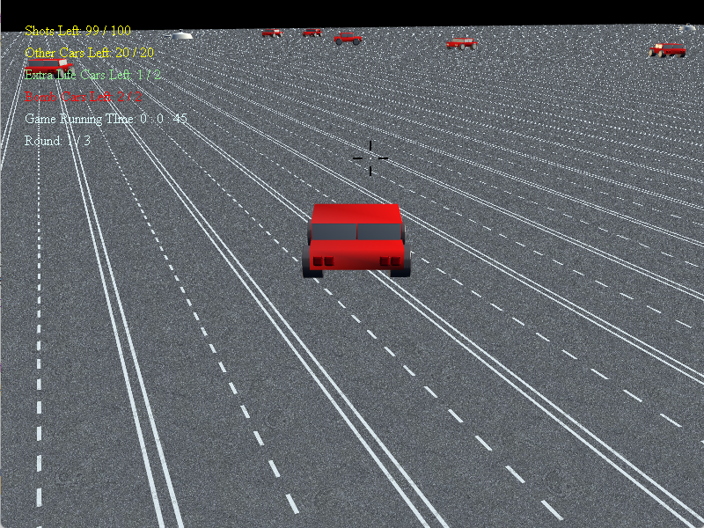

But you can pick up extra lives (looks like cars but doing 360s) in case you do get hit!

Slide 6
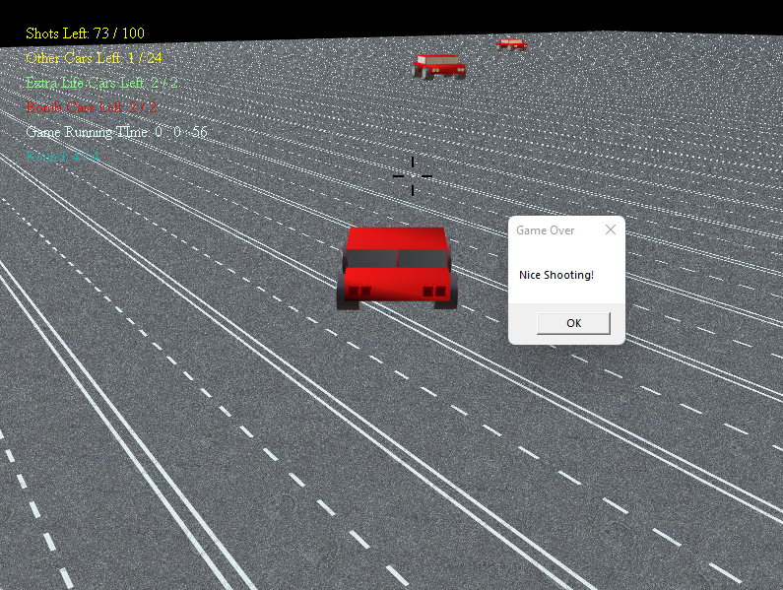
End goal is to shoot all the cars in every round to earn 24 points to win!

